Slide 1
CSE 11
Accelerated Intro to Programming Discussion Section 7
Sachin Deshpande
Summer 1 2021
This discussion is being recorded

Slide 2
Logistics
PA7 released Sunday!
Exam1 grading in progress. Will be done by next exam

Slide 3





















More array and loops
Array of primitive type:
int[] arr = new int[10];
Array of class type:
TextTweet[] arr = new TextTweet[10];
Array of interface type:
Tweet[] arr = new Tweet[10];

Slide 4





















More array and loops
Given an array of integers, return positive integers in the array
int[] findPositives(int[] nums){ int numberPositive = 0;
for (int num: nums){ if (num > 0){
numberPositive += 1;
}
}
int[] positives = new int[numberPositive]; int index = 0;
for (int num: nums){ if (num > 0){
positives[index] = num; index += 1;
}
}
return positives;
}

Slide 5















More array and loops
Given an array of strings, convert the strings into uppercase
String[] toUpper(String[] strs){
String[] upperStrs = new String[strs.length]; for (int i = 0; i < strs.length; i++){
upperStrs[i] = strs[i].toUpperCase();
}
return upperStrs;
}

Slide 6
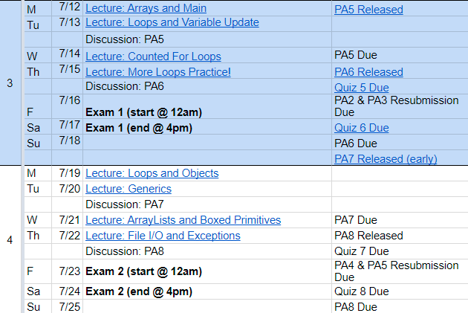
Quick Midterm Review
Loops will be on the midterm!

Slide 7
Code Example

Slide 8




PA7
Start early!

Slide 9
Thanks!

